Slide 1
Airbnb Business Model
INFO 579 Group 3
Yitian Qian, Mac Borozan, Jiayue He, Bharath Naveen, Li Mi
Notes:
Yitian
Hi everyone, we are group 3. And the business model that our project focuses on is the Airbnb business model.

Slide 2
SECTIONS
Airbnb Introduction
1
ER Diagram
2
Model Assumptions
3
Relational Model
4
Create Tables and Insert Data
5
Business Tasks and Retrieve Data using SQL
6
Notes:
Yitian
Our presentation will have these sections:
Airbnb introduction, ER diagram, model assumptions, relational model, create tables and insert data, and business tasks and retrieve data using SQL.

Slide 3

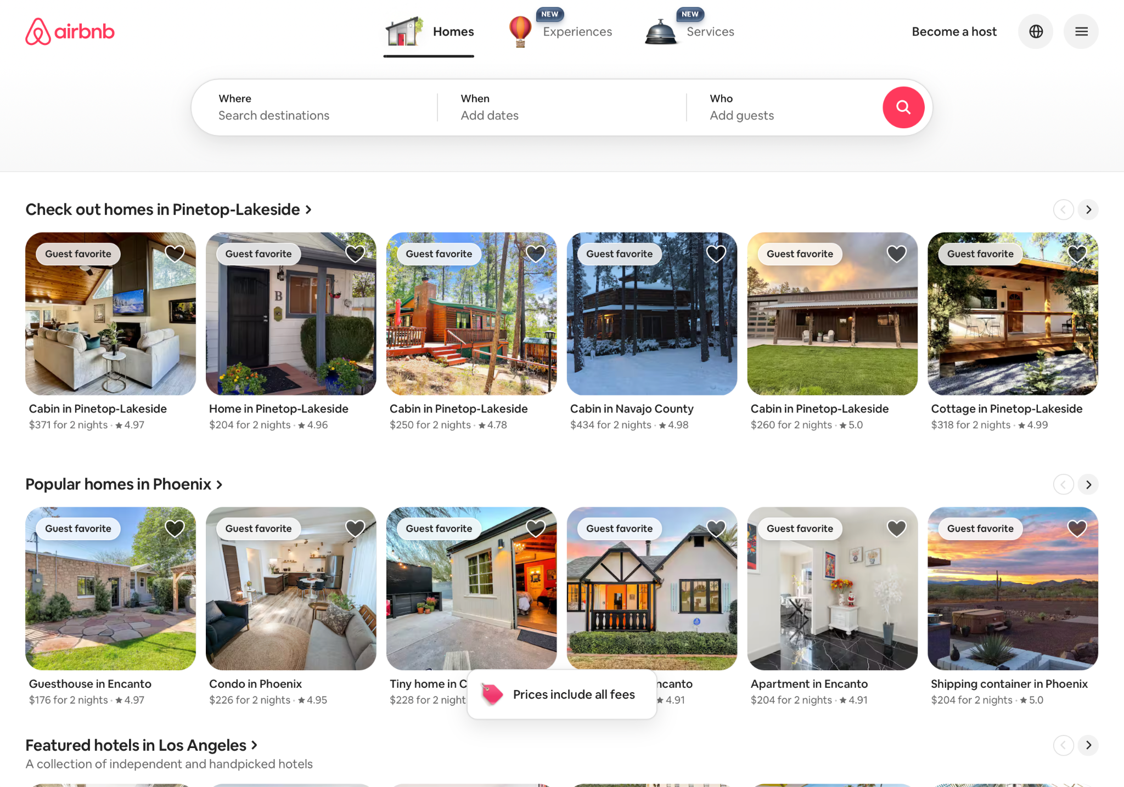
Airbnb Introduction
Section 1
Notes:
Yitian
Airbnb is an online booking platform for short-term and long-term homestays in many countries and regions. There are a variety of stays hosted by individuals and businesses.
And it is a global marketplace for guests all over the world for travelling.
Picture citation: https://www.campaignlive.co.uk/article/airbnb-unveils-global-rebrand-symbol-of-belonging/1303932

Slide 4




Our Airbnb model…
Mimic the actual structure
Simplify into some key entities and relationships
Use SQL statements to retrieve data
Notes:
Yitian
And our airbnb model is designed to mimic the actual structure of the real Airbnb business, focusing on how guests, hosts, listings, bookings, insurance, etc. interact.
We simplified the platform’s real operations into some key entities and relationships, such as guests booking listings, hosts managing listings, and amenities being provided in listings, and so on.
Our model captures the most essential elements in Airbnb business and then we use SQL statements to retrieve data to solve some tasks in possible business situations.

Slide 5
ER Diagram
Section 2
Notes:
Mac: First,
making bookingdetails a strong entity, n-ary relationship

Slide 6
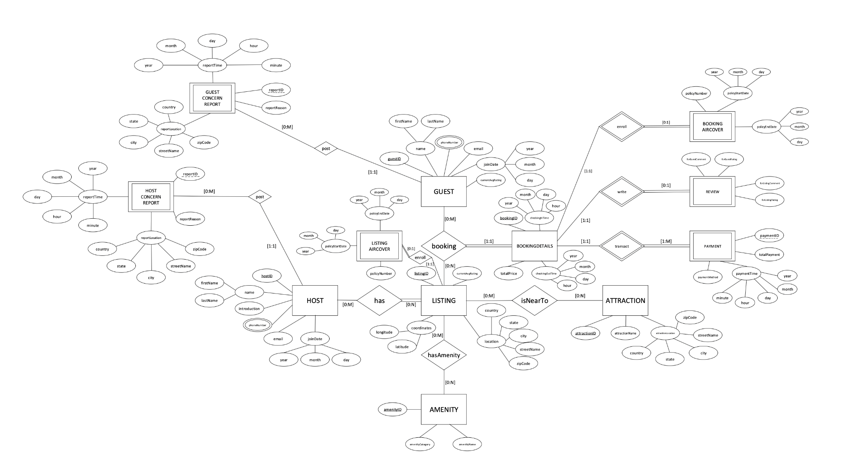
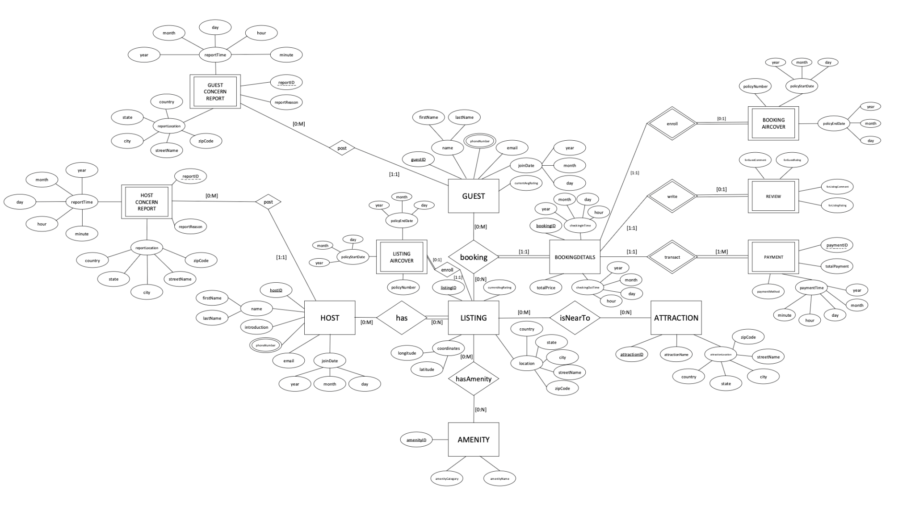
ER Diagram
Section 2
Notes:
Mac:
Booking details most important entity, because that is the business
We weren’t sure if we should make bookingdetails a strong entity,
bookingID is relevant to the identity of booking aircover, review, and payment
But we made it a strong entity for business use because there are no rules
Became our n-ary relationship (more than 2 entities)
making bookingdetails a strong entity, n-ary relationship

Slide 7
ER Diagram
Section 2
Notes:
Mac: making bookingdetails a strong entity, n-ary relationship

Slide 8
ER Diagram
Section 2
Back
Notes:
Mac: making bookingdetails a strong entity, n-ary relationship

Slide 9
Section 2
BACK
Notes:
Mac: making bookingdetails a strong entity, n-ary relationship

Slide 10
Section 2
Back
Notes:
Mac: making bookingdetails a strong entity, n-ary relationship

Slide 11
Model Assumptions - OVERVIEW
We group our model assumptions into four major categories:
User- Level Assumptions
Listing & property structure assumptions.
Booking, review and payment workflow assumptions
AirCover, Reports & external relations.
Section 3
Notes:
Bharath, presenter notes:
Before we dive into the details, we categorize our assumptions into four buckets.
This makes the model more structured and easier to understand.
I’ll break each category down with the logic behind it.

Slide 12

Users can register as Guest or Host.
A user can have multiple phone numbers.
Each Guest can post multiple Guest Concern Reports.
Each Host can post multiple Host Concern Reports.
Phone numbers stored separately (1:M relationship)
Reports tied directly to the user who submitted them.
No cross-reporting (Guests cannot file Host reports, etc.)
User - Level Assumptions
Notes:
Bharath, presenter notes:
Users are the core of our system, and we assume they register as either Guest or Host.
People often have multiple phone numbers > personal, work, international > so we allow unlimited numbers.
Concern reports are tied strictly to the user who submits them. Guests files Guest reports, hosts files Host reports > keeps responsibility clear.

Slide 13

A host may have 0 to many Listings.
A Listing can have 0 to many Hosts (co-hosts; Airbnb-managed allowed)
Listing and amenities have a many-to-many relationship.
Attractions are modeled separately and can be near many Listings.
Some listings are curated directly by Airbnb -> Hosts count can be 0.
Amenities are standardized (e.g, WiFi, Pool, AC)
Attractions help with listing visibility and tourism relevance.
2. Listing & Property Structure Assumptions
Notes:
Bharath, presenter notes:
Hosts can be individuals or professional managers, so we allow many listings per host.
Co-hosting is common on Airbnb, so one listing can have multiple hosts > and in rare cases none, if Airbnb manages it.
Amenities aren’t unique > Wi-Fi or AC can exist in hundreds of listings, so we use a many-to-many structure.
Attractions like parks or museums are stored separately because they relate to multiple listings.

Slide 14



Guest ↔ Listing is many-to-many via Bookings
No overlapping bookings
Each booking has exactly one BookingDetails
A booking can have 0 or 1 Review
Each Review includes:
Guest rating
Listing rating
Each booking must have ≥ 1 Payment
Additional payments allowed (services, fines)
Extended Details:
BookingDetails store exact check-in/check-out timestamps
Review stored in one entity instead of separate guest/listing reviews
Payments include method, timestamp, and amount breakdown
3. Booking, review and payment workflow assumptions
Notes:
Bharath, presenter notes:
Bookings are the center of the system , they connect guests and listings
We assume bookings can’t overlap because one listing cannot be occupied twice at the same time.
Every stay has exactly one set of stay details, even if the guest modifies the booking.
Reviews are bundled together, the host rates the guest and the guest rates the listing in the same object.
At least one payment must exist to finalize a booking, but more can be added.

Slide 15


Guest ↔ Listing is many-to-many via Bookings
AirCover is optional Listings may have 0 or 1 Listing AirCover BookingDetails may have 0 or 1 Booking AirCover
Concern Reports:
Guests → Guest Reports
Hosts → Host Reports
External Relations:
Listings ↔ Attractions = many-to-many
Extended Details:
AirCover follows Airbnb’s insurance model
Report system separates responsibilities clearly
Many-to-many with Attractions supports flexible discovery
4. AirCover, Reports & external relations.
Notes:
Bharath, presenter notes:
AirCover is Airbnb’s optional insurance program, so we modeled it as optional too.
Both listings and bookings can have their own AirCover because protection applies at two levels.
Concern reporting is entirely user-initiated > guests file guest-type reports and hosts file host-type reports.
Attractions give listings more visibility and help search algorithms.

Slide 16
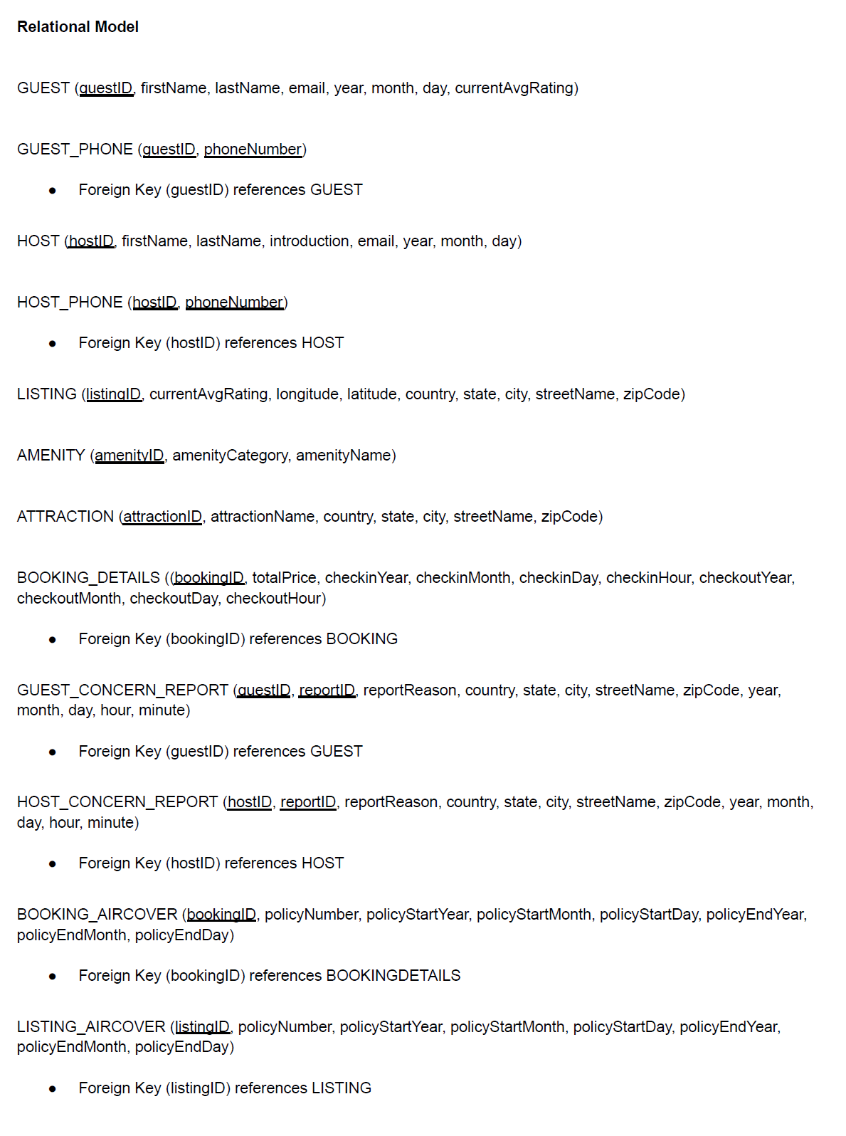
Relational Model
Identified all major real-world concepts involved in the Airbnb-style system (guest, host, listing, booking, payment, reviews, reports)
Defined relationships between these entities (1-to-1, 1-to-many, many-to-many).
Assigned primary keys to uniquely identify each entity and added foreign keys to enforce referential integrity.
Converted the ER diagram into relational schemas, including associative tables for many-to-many relationships and weak entities.
Section 4
Notes:
Jiayue: This slide presents the relational model we designed for our Airbnb database system,Our goal was to capture all the key entities,while ensuring strong data integrity and supporting realistic business operations. The processes including:

Slide 17
Strong Entities:
GUEST (PK: guestID)
firstName, lastName, email, year, month, day, currentAvgRating
HOST (PK: hostID)
firstName, lastName, introduction, email, year, month, day
LISTING (PK: listingID)
currentAvgRating, longitude, latitude, country, state, city, streetName, zipCode
AMENITY (PK: amenityID)
amenityCategory, amenityName
ATTRACTION (PK: attractionID)
attractionName, country, state, city, streetName, zipCode
BOOKING_DETAILS (PK: bookingID)
totalPrice, checkinYear, checkinMonth, checkinDay, checkinHour, checkoutYear, checkoutMonth, checkoutDay, checkoutHour
Notes:
Jiayue: we started by identifying all the essential entities from the domain, such as guests, hosts, listings, bookings, amenities, attractions, and booking details. Then we analyzed how these entities interact in the real world, which helped us determine the cardinalities and constraints, such as one guest having many bookings or a listing having many amenities. Then, we assigned primary keys to each strong entity

Slide 18
GUEST_PHONE (guestID, phoneNumber)
Foreign Key (guestID) references GUEST
HOST_PHONE (hostID, phoneNumber)
Foreign Key (hostID) references HOST
GUEST_CONCERN_REPORT (guestID, reportID, reportReason, country, state, city, streetName, zipCode, year, month, day, hour, minute)
Foreign Key (guestID) references GUEST
HOST_CONCERN_REPORT (hostID, reportID, reportReason, country, state, city, streetName, zipCode, year, month, day, hour, minute)
Foreign Key (hostID) references HOST
BOOKING_AIRCOVER (bookingID, policyNumber, policyStartYear, policyStartMonth, policyStartDay, policyEndYear, policyEndMonth, policyEndDay)
Foreign Key (bookingID) references BOOKINGDETAILS
REVIEW (bookingID, forGuestComment, forGuestRating, forListingComment, forListingRating)
Foreign Key (bookingID) references BOOKINGDETAILS
Weak Entities:
LISTING_AIRCOVER (listingID, policyNumber, policyStartYear, policyStartMonth, policyStartDay, policyEndYear, policyEndMonth, policyEndDay)
Foreign Key (listingID) references LISTING
PAYMENT (bookingID, paymentID, totalPayment, paymentMethod, year, month, day, hour, minute)
Foreign Key (bookingID) references BOOKINGDETAILS
HOST_HAS_LISTING (hostID, listingID)
Foreign Key (hostID) references HOST
Foreign Key (listingID) references LISTING
LISTING_HAS_AMENITY (listingID, amenityID)
Foreign Key (listingID) references LISTING
Foreign Key (amenityID) references AMENITY
LISTING_IS_NEAR_TO_ATTRACTION (listingID, attractionID)
Foreign Key (listingID) references LISTING
Foreign Key (attractionID) references ATTRACTION
BOOKING (guestID, listingID, bookingID)
Foreign Key (guestID) references GUEST
Foreign Key (listingID) references LISTING
Foreign Key (bookingID) references BOOKINGDETAILS
Notes:
Jiayue: Next, we created associative entities with composite keys for the many-to-many relationships, like listing–amenity or host–listing. Finally, we added foreign keys to enforce referential integrity and converted the entire ER diagram into structured relational schemas. This resulted in a complete, normalized model that accurately represents the system.

Slide 19
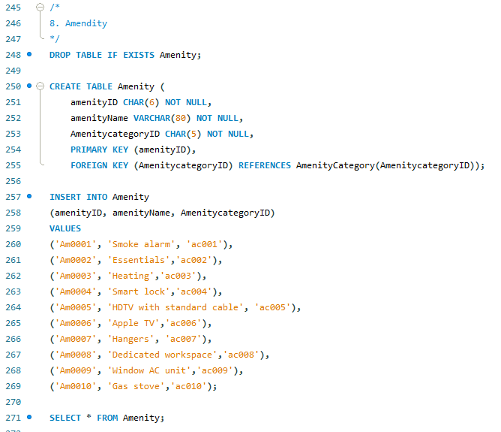
Create Tables and Insert Data
Created 20 relational tables in MySQL with primary keys, foreign keys, and constraints to ensure data consistency and reflect real-world relationships.
Set up bridge tables to model relationships between entities(e.g., listings and amenities, listings and attractions, hosts and listings).
Inserted sample data: Insert the personal information, geo-coordinates, ratings, booking details, payments, reviews, and insurance coverage.
Section 5
Notes:
Li
So based on the previous ER diagram and relational model, we need to create 20 tables, also include bridge tables since many of them are many-to-many relationship. As you can see the coding picture, firstly, we create the table, then, set up the column names and schema, specify the primary key and foreign key, finally insert the data into the table.
Next, you’ll see screenshots of all the tables after the data has been inserted.

Slide 20
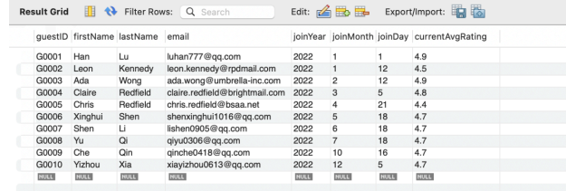
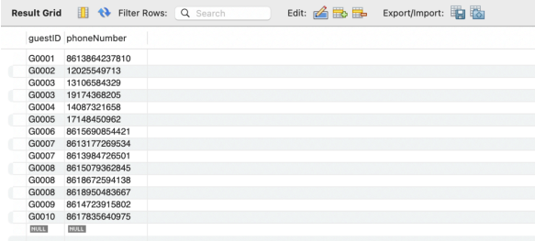
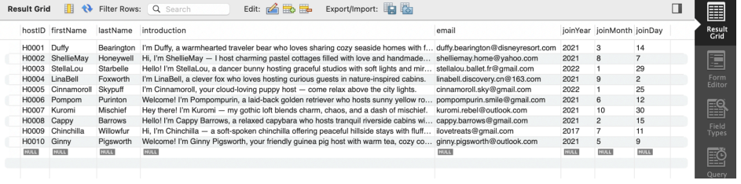
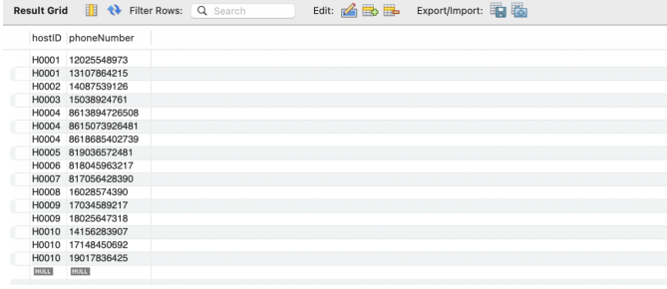
Guest
GuestPhone
Host
HostPhone
Notes:
Li
Guest table, includes all the Guests personal information. GuestPhone
Host personal information and Hostphone
I gonna quickly go through this

Slide 21
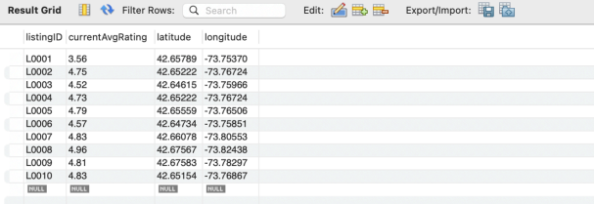
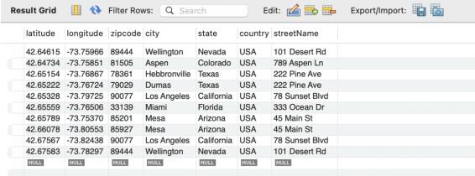
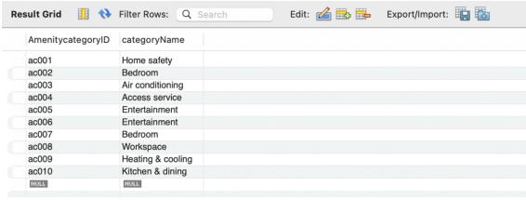
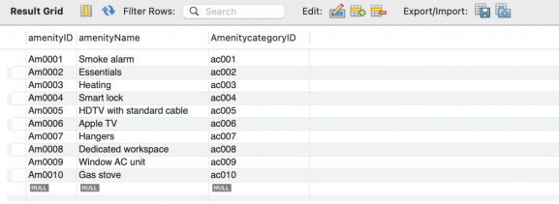
Listing
Listing_location
AmenityCategory
Amenity
Notes:
Li
Listing means the property listed on Airbnb.
Here we create a separate table for Listing_location because subsequent column names depend solely on Latitude and Longitude. Otherwise, a transitive dependency would exist.
All the Amenity, AmenityCategory information you could find over here.

Slide 22
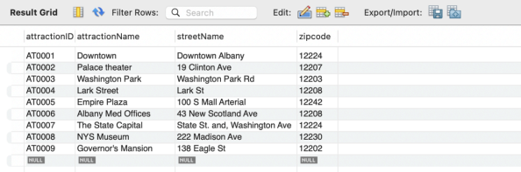
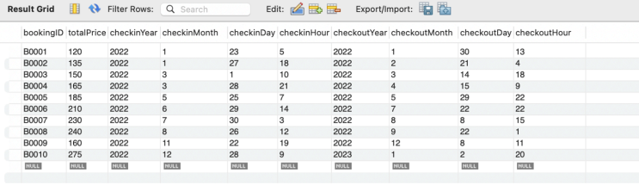
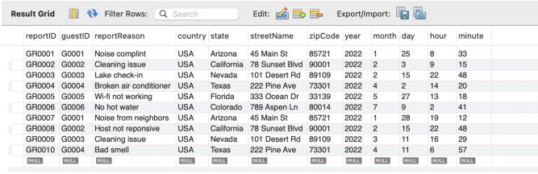
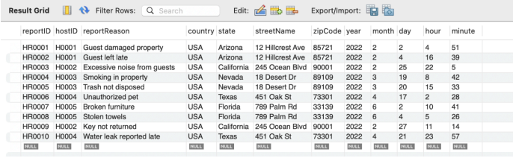
Attraction
Booking_detail
Guest_Concern_Report
Host_Concern_Report
Notes:
Li
Attraction: fun places nearby
Bookin_detail: all the booking information stores into this table
Guest_concern_report/ Host_concern_report means complaint records from guest s and hosts

Slide 23
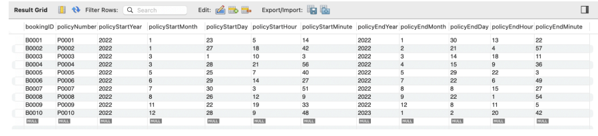
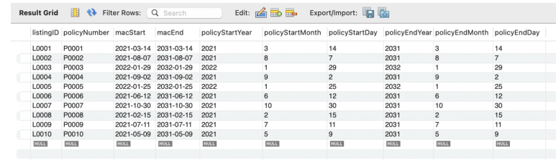
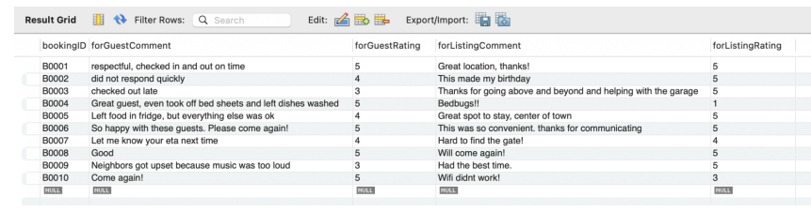
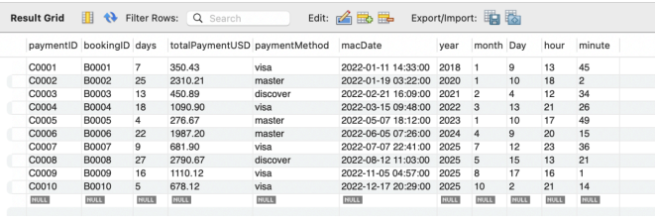
Booking_Aircover
Listing_Aircover
Review
Payment
Notes:
Li
Booking_Aircover
For the booking_aircover table, this one records insurance coverage information at the booking level.
Listing_Aircover
The listing_aircover table is very similar
Rivew information, Payment information

Slide 24
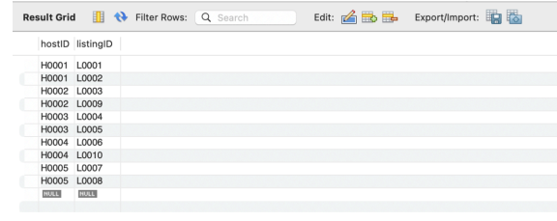
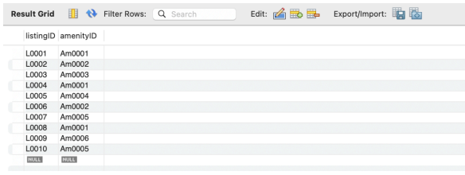
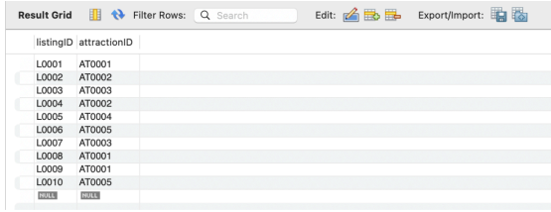
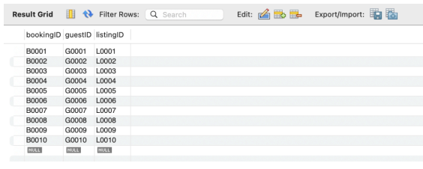
Host_Has_Listing
Listing_Has_Amenity
Listing_Is_Near_
To_Attraction
Booking
Notes:
Li
These four tables are all bridge tables that help handle Airbnb’s many to many relationships.
Host_HAS_Listing: connects hosts and their listings. A host can manage multiple listings.
Same as Listing_HAS_Amenity and listing_is near_to attraction
Booking acts like a transaction-level bridge table between guests and listings. It tells us which guest booked which listing

Slide 25
Business Tasks and Retrieve Data using SQL
1. Identify which amenities each guest experienced at the listings they booked. Airbnb can analyze guests' preferences regarding amenities, so that in the future, airbnb can prioritize and recommend the listings with those amenities, providing personalized search results.
2. List all hosts and shows their listing details and aircover insurance information when available. This helps Airbnb understand which hosts are actively hosting.
3. The quality team wants to identify the top-rated listings on the platform so they can feature them in marketing campaigns or “Superhost picks”. They want to see all listings whose rating equals the maximum current average rating in the system.
Section 6
Notes:
Yitian
So the next section is about some possible business tasks and how to retrieve data using SQL to solve these tasks
We will talk about them one by one with details later. To briefly preview the tasks,
Identify which amenities each guest experienced at the listings they booked
List all hosts with their listing details and available insurance information
Identify the top-rated listings

Slide 26
Business Tasks and Retrieve Data using SQL
4. The trust & safety team wants to see all listings owned by hosts who have ever submitted a concern report about guests. These hosts may be stricter or have had problematic guest experiences, so their listings might need tailored guidance or extra support.
5. The business team wants to know revenue by city and payment method, to see where most money comes from and which payment methods are used in each city.
6. Identify guests who have never filed any concern reports, which helps Airbnb identify low-risk, satisfied guests. The marketing or loyalty team can target these guests with special discounts or early-access offers to encourage repeat bookings.
Section 6
Notes:
Yitian
List all listings owned by hosts who have ever submitted a concern report about guests
Show revenue by city and payment method
Identify guests who have never filed any concern report.

Slide 27
Business Tasks and Retrieve Data using SQL
7. Create a single combined incident log of all reports from both guests and hosts. Customer support and risk teams can use this unified view to monitor patterns, prioritize investigations, and track overall platform safety across both sides of the marketplace.
8. Identify listings which have not been booked. These listings can be analyzed for undesirable qualities and for fixing to ensure all listings are high quality.
Section 6
Notes:
Yitian
Present a combined incident log of all concern reports from both guests and hosts.
Identify listings that have not been booked.

Slide 28
Business Tasks and Retrieve Data using SQL
9. Average the listing ratings for bookings which do not have associated concern reports. When compared to the overall average rating (4.3) it seems that even if there are factors which detract from the rating, customers are not writing concern reports. Airbnb could institute a change in how concern reports are made to make it easier for unsatisfied customers to be identified and helped.
10. As an Operations Manager at Airbnb, probably teams want to know which listings currently have AirCover coverage fully enabled. So in our datasets, we can check the listings that have a coverage start date and end date entered in the Listing_Aircover table.
Section 6
Notes:
Yitian
Find the average listing rating for bookings that have no concern reports.
List the listings that currently have insurance coverage fully enabled.
So we are interested in solving these 10 business tasks because they can happen in real-life business operations, and also altogether fulfill the requirements of the project.

Slide 29
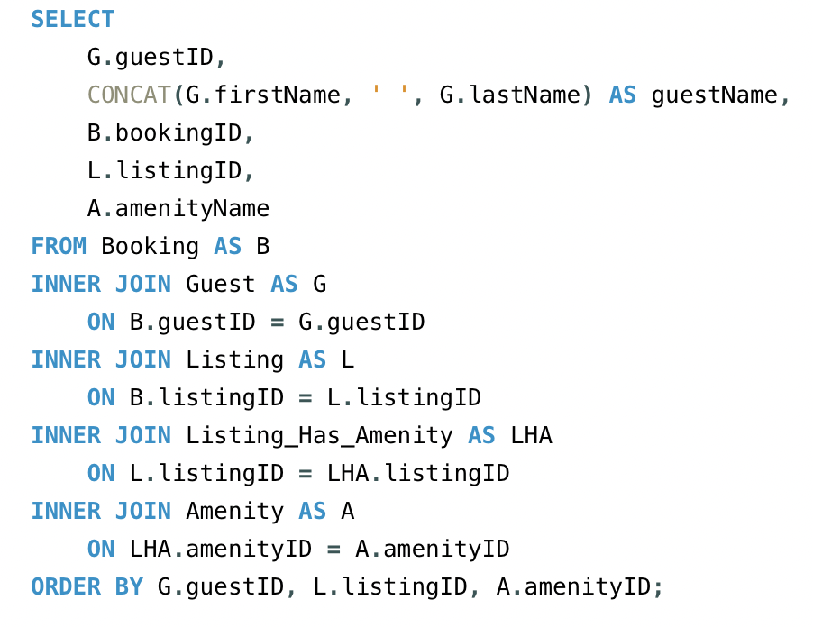
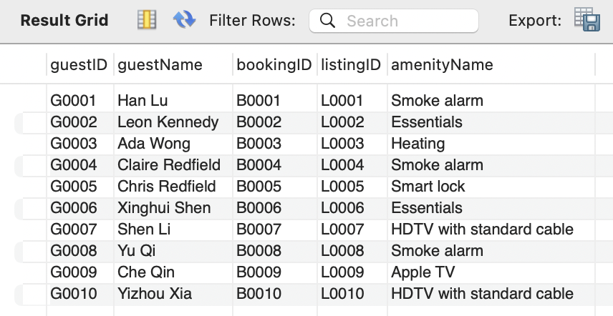
Business Task 1:
Identify which amenities each guest experienced at the listings they booked. Airbnb can analyze guests' preferences regarding amenities, so that in the future, airbnb can prioritize and recommend the listings with those amenities, providing personalized search results.
Notes:
Yitian
So this is the first business task.
Identify which amenities each guest experienced at the listings they booked. Airbnb can analyze guests' preferences regarding amenities, so that in the future, airbnb can prioritize and recommend the listings with those amenities, providing personalized search results.
As we can see here, we used INNER JOINs to join tables Booking, Guest, Listing, Listing_Has_Amenity and Amenity. So the information we need to solve this task can be presented in a single table output.
For example, Leon S Kennedy lived in a listing with Essentials.
If we have a lot of data available, then we can analyze the common amenities among all the listings that a guest booked, and then the system can recommend the listings that have those amenities at the website frontpage.

Slide 30
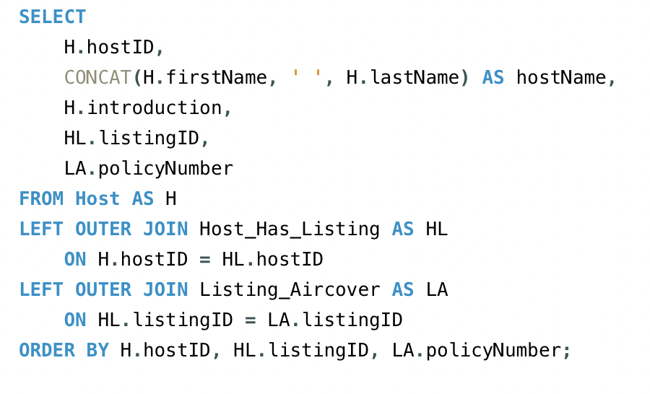
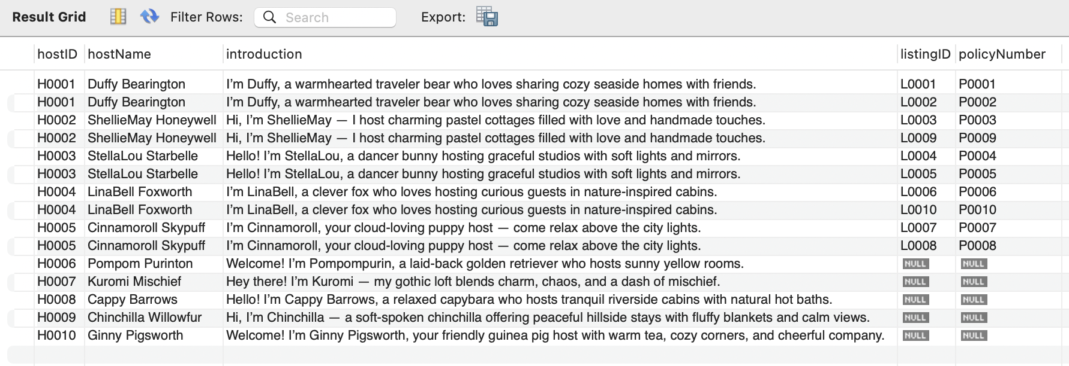
Business Task 2:
List all hosts and shows their listing details and aircover insurance information when available. This helps Airbnb understand which hosts are actively hosting.
Notes:
Yitian
And this is the second task.
List all hosts and shows their listing details and aircover insurance information when available. This helps Airbnb understand which hosts are actively hosting.
We used LEFT OUTER JOIN on Host to join Host_Has_Listing and Listing_Aircover. So we can see in the output table that all the rows from Host remained, even some listings that have no available insurance information. The host Duffy Bearington has a listing and the listing aircover, which is the airbnb insurance; while the host Pompom Purinton currently has no listing under his name and also no insurance.

Slide 31
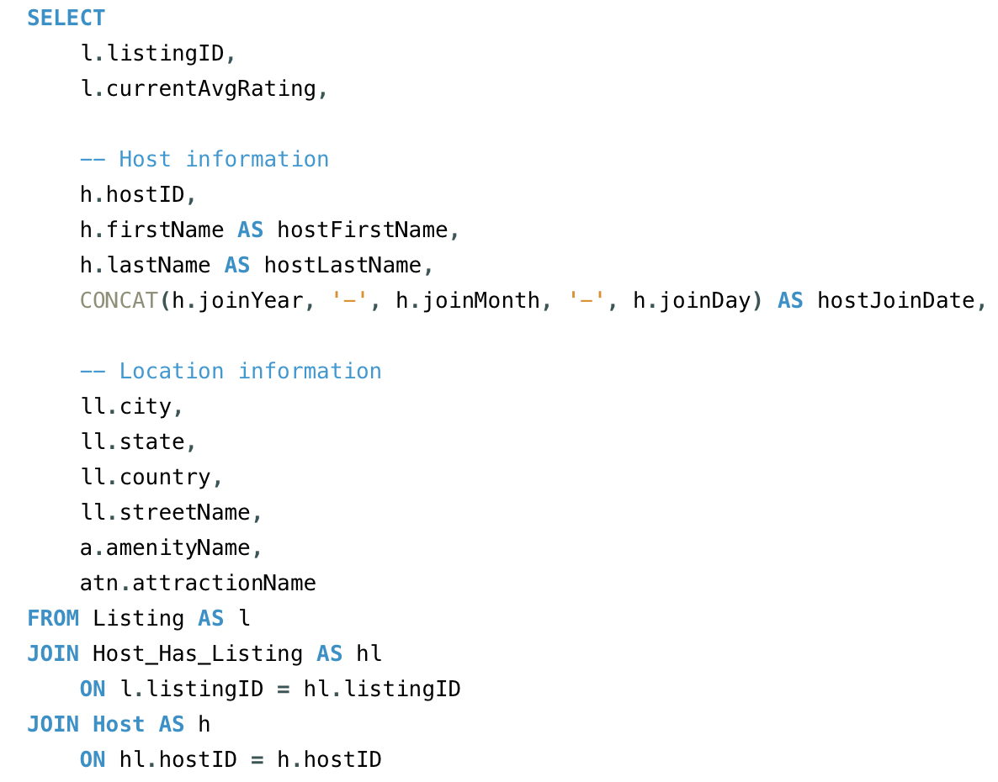
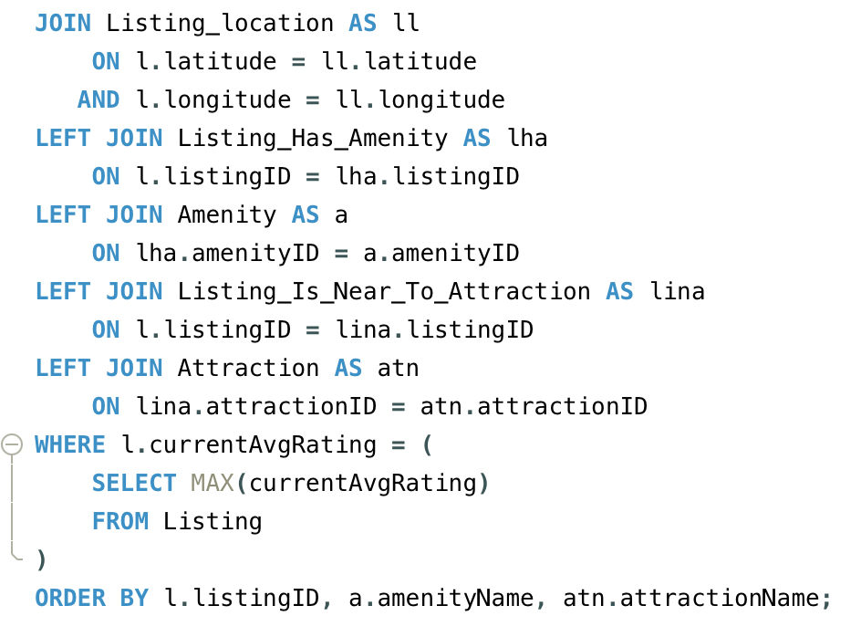
Business Task 3:
The quality team wants to identify the top-rated listings on the platform so they can feature them in marketing campaigns or “Superhost picks”. They want to see all listings whose rating equals the maximum current average rating in the system.
Notes:
Jiayue: The third business case comes from the quality team, they want to identify the top-rated listings on the platform so they can feature them in marketing “Superhost picks”. They want to see all listings whose rating equals the maximum current average rating in the system.
The key part is the WHERE clause: I filter listings so that currentAvgRating equals the maximum rating computed in a subquery. This guarantees that only the top-rated listings appear.

Slide 32
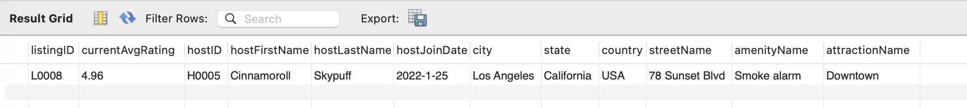
Business Task 3:
The quality team wants to identify the top-rated listings on the platform so they can feature them in marketing campaigns or “Superhost picks”. They want to see all listings whose rating equals the maximum current average rating in the system.
Notes:
Jiayue: the result grid on the slide shows the result, a listing with a 4.96 rating, along with its host, location, amenity, and nearby attraction.

Slide 33
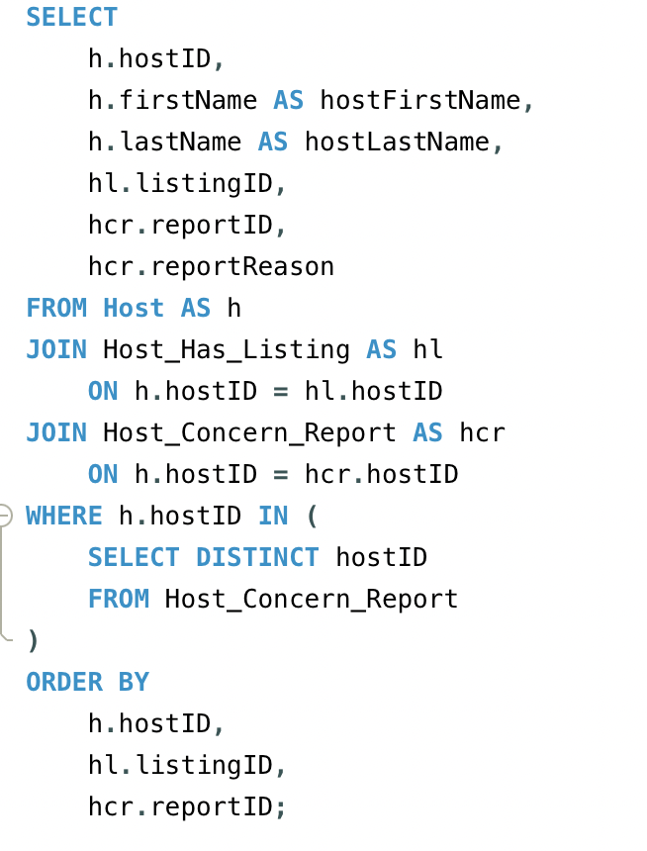
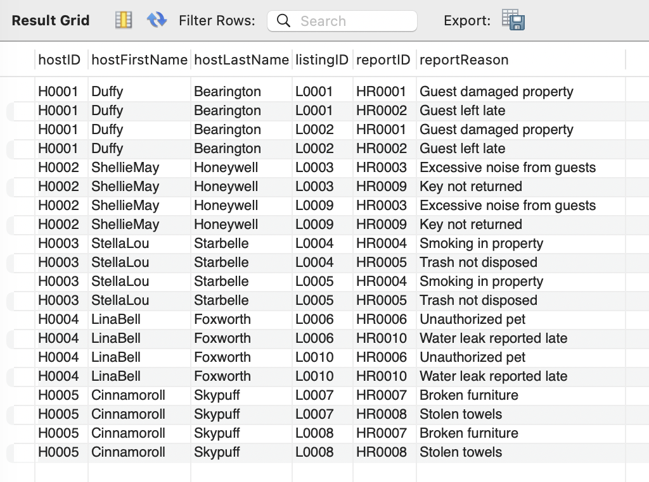
Business Task 4:
The trust & safety team wants to see all listings owned by hosts who have ever submitted a concern report about guests. These hosts may be stricter or have had problematic guest experiences, so their listings might need tailored guidance or extra support.
Notes:
Jiayue: the fourth business case, is from the trust & safety team. They want to see all listings owned by hosts who have ever submitted a concern report about guests. These hosts might have stricter expectations or have experienced more problems, so their listings may need additional guidance or support.
In the SQL, I start from the Host table and join to Host_Has_Listing to get each host’s listings. Then I join to Host_Concern_Report to bring in the reports those hosts have filed and the reasons.
The result grid on the right shows, for each host, which listings they own and which report IDs and reasons are associated with them

Slide 34
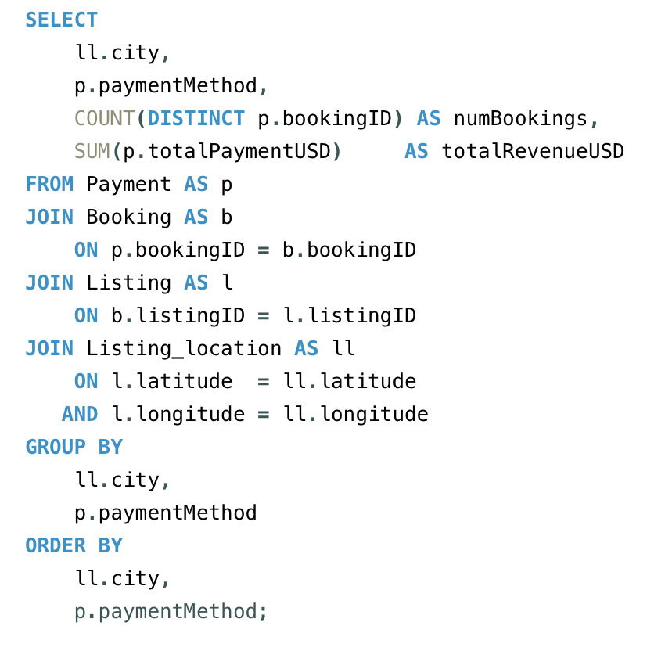
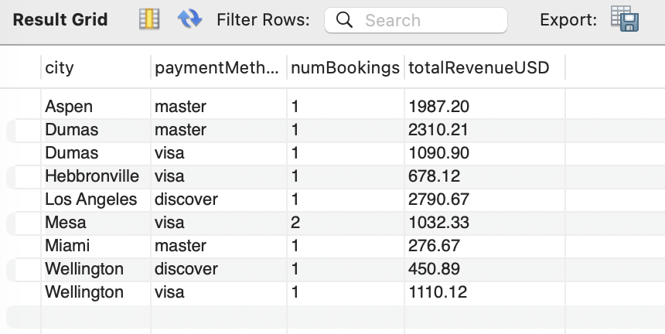
Business Task 5:
The business team wants to know revenue by city and payment method, to see where most money comes from and which payment methods are used in each city.
Notes:
Jiayue: The fifth business case comes from the business team. They want to understand revenue by city and by payment method, so they can see where most money comes from and which payment options are actually used in each location.
In this query, I start from the Payment table and join it to Booking, Listing, and then to Listing_location so I can attach each payment to a specific city. I then group the results by city and paymentMethod. For each group, I calculate two metrics: the number of unique bookings using COUNT(DISTINCT p.bookingID) and the total revenue using SUM(p.totalPaymentUSD). Finally, I order the output by city and payment method to make it easy to scan.
The result grid on the right shows, for example, that in Mesa, Visa generated two bookings and just over $1,000 in revenue. This kind of breakdown helps the business team decide which cities to target and which payment methods are most important to support.”

Slide 35
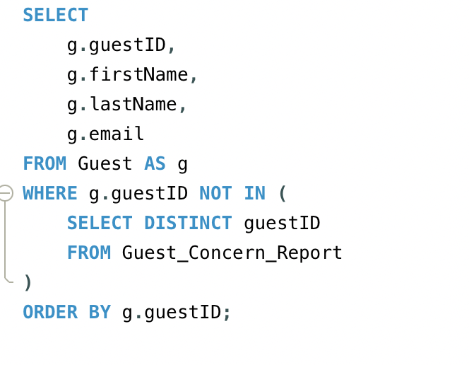
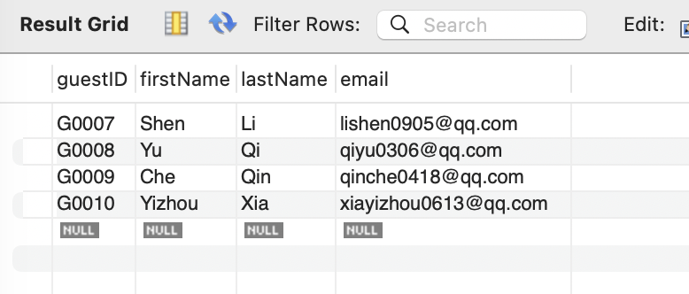
Business Task 6:
Identify guests who have never filed any concern reports, which helps Airbnb identify low-risk, satisfied guests. The marketing or loyalty team can target these guests with special discounts or early-access offers to encourage repeat bookings.
Notes:
Bharath, presenter notes:
For Business Task 6, we wanted to find low-risk, happy guests basically people who’ve never raised a concern on the platform.
The idea is: if a guest has never filed a complaint, they’re probably easier to work with and more satisfied.
Marketing or loyalty teams can target these guests with special discounts, referral offers, or early-access to new features to drive repeat bookings.

Slide 36
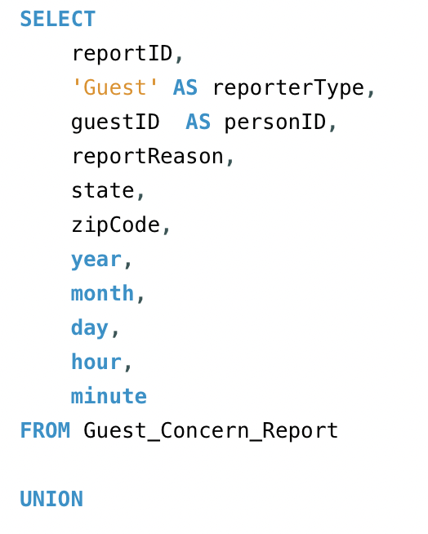
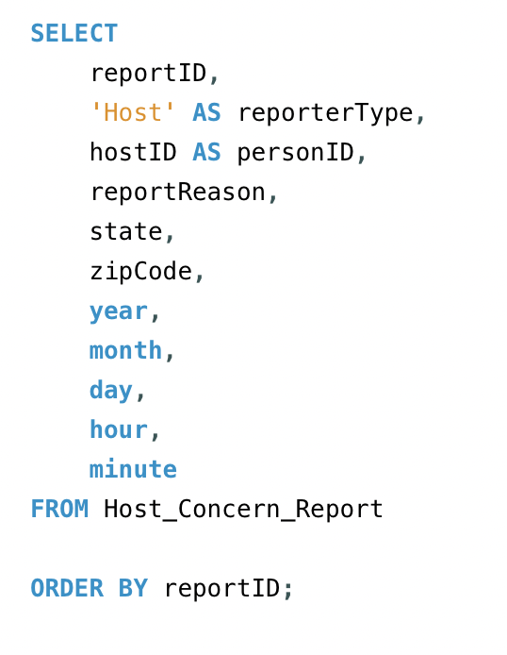
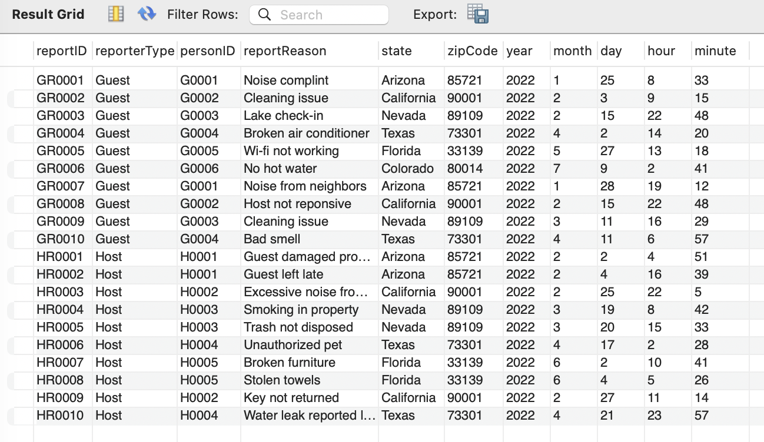
Business Task 7:
Create a single combined incident log of all reports from both guests and hosts. Customer support and risk teams can use this unified view to monitor patterns, prioritize investigations, and track overall platform safety across both sides of the marketplace.
Notes:
Bharath presenter notes:
Business Task 7 is about giving support and risk teams one consolidated incident log from both sides of the marketplace guests and hosts.
Instead of checking separate tables for guest reports and host reports, we create one combined view. That helps customer support:
monitor patterns in complaints
prioritize serious issues, and
track overall platform safety over time.
Guest and host reports individually tell only one side of the story, but the unified log lets Airbnb analyze trends, fairness, geographic hotspots, severity levels, and marketplace balance across the entire platform. Without combining them, you only ever see half the truth.

Slide 37
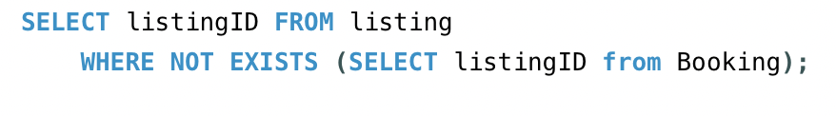
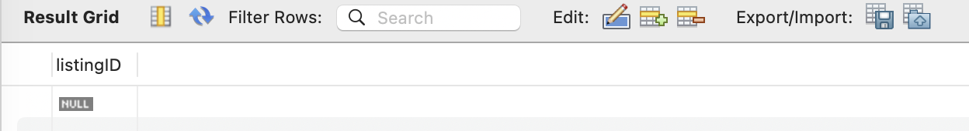
Business Task 8:
Identify listings which have not been booked. These listings can be analyzed for undesirable qualities and for fixing to ensure all listings are high quality.
Notes:
mac

Slide 38
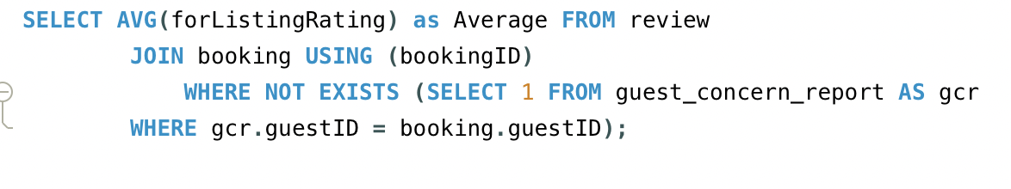
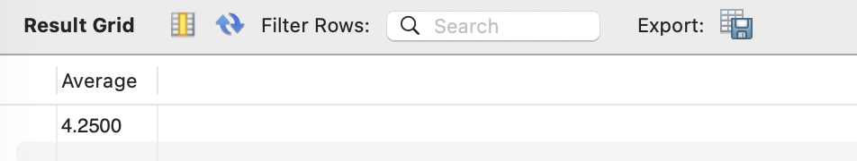
Business Task 9:
Average the listing ratings for bookings which do not have associated concern reports. When compared to the overall average rating (4.3) it seems that even if there are factors which detract from the rating, customers are not writing concern reports. Airbnb could institute a change in how concern reports are made to make it easier for unsatisfied customers to be identified and helped.
Notes:
mac

Slide 39
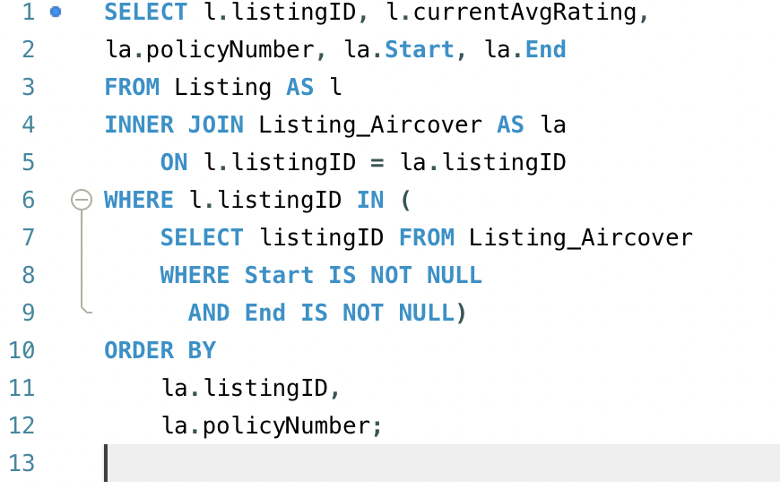
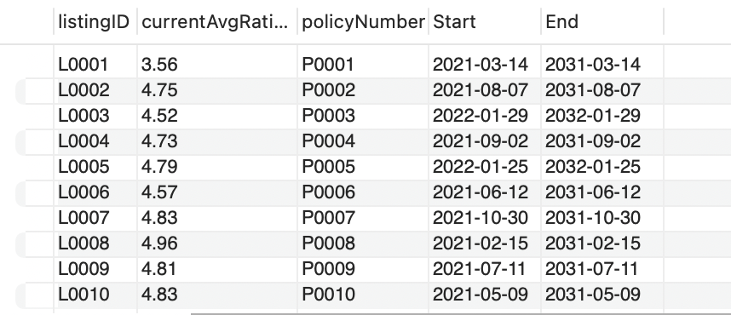
Business Task 10:
As an Operations Manager at Airbnb, probably teams want to know which listings currently have AirCover coverage fully enabled. So in our datasets, we can check the listings that have a coverage start date and end date entered in the Listing_Aircover table.
Notes:
Li
For the operations manager at Airbnb, they might need to know which listings currently have AirCover coverage fully enabled.
What we did here is that we used a subquery within the where-in clause. First, it filters all listingIDs from the listing_aircover where both start and end are not null(no). Then, the outer query joins this filtered list, and finally, get the information that we selected.
So we can see the final result: all listings that currently have valid aircover dates. This might help operation teams quickly verify insurance coverage across the platform.

Slide 40

Some notes during our project …
Since we implemented artificial data to fill in our tables, we noticed that there were many constraints among different sets of information.
Dividing the project into steps really helped us organize the entire process and achieved the final results.
Cooperating on database project was not as easy as we thought and not as difficult as we thought.
Notes:
Yitian
During the process of our project, every member has contributed a lot and we have great collaboration with each other. And there are some things we noticed during the project.
Firstly, since we mimicked the airbnb business and created the database, it was difficult to find real data from airbnb, so we implemented artificial data to fill in the database. And there were many data constraints among different tables that needed to be satisfied. For example, the guest insurance duration must be within the checking in and checking out time, etc.
And the second point is that, dividing the project into steps really helped us organize the entire process.
And lastly, cooperating on database project was not as easy as we thought. There could be many data conflicts if everyone modifies the database at the same time. So the method we took was that, some tasks were assigned to a single person to implement to avoid conflicts, and others will check if there are any mistakes.
So in general, i think our group did a great collaboration.
Picture citation: https://www.microsoft.com/en-us/sql-server/sql-server-2019

Slide 41
Thank you!
The End
INFO 579 Group 3
Yitian Qian, Mac Borozan, Jiayue He, Bharath Naveen, Li Mi
Notes:
Yitian
And that’s all for our project presentation. Thank you for listening.

